Slide 1
Genetic Algorithm Continued

Slide 2
Fitness Evaluation and Selection
Different Selection Schemes
Canonical Selection
Roulette Wheel Selection
Rank-based Selection
Tournament Selection
Steady-State Selection

Slide 3
GA Operations
Encoding
Fitness Evaluation and Selection
Mating Pool
Crossover
Mutation
Inversion
Convergence Test

Slide 4
GA Selection
Once the encoding scheme is decided, the next important decision to be taken is how to perform selection from a set of population, i.e., how to choose individuals in the population for creating offsprings in the next generation, and also how many offsprings to create.
A common strategy is to emphasize the fittest individuals in the population with the hope that their offspring will have higher fitness

Slide 5
Fitness Evaluation
We want the next generation to give us a solution that is closer to the optimal solution
Hence, random population generation is not recommended
A better strategy is to follow the biological selection process
Selection takes into consideration
Survival of the fittest
Struggle for existence
Fitness evaluation is a measure of survivability of each individual in the current population

Slide 6
Issues to Consider During Fitness Evaluation
Single Objective or multiple objectives?
Scaling problem

Slide 7
Fitness Evaluation
Each individual x is assigned with a fitness value f(x) as the measure of performance
It is assumed that better the individual as a solution, the fitness value is higher
The objective function can itself be the fitness function itself if it is properly defined

Slide 8
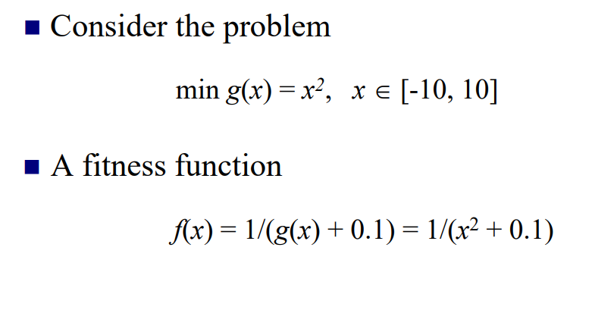
Fitness Evaluation Example

Slide 9
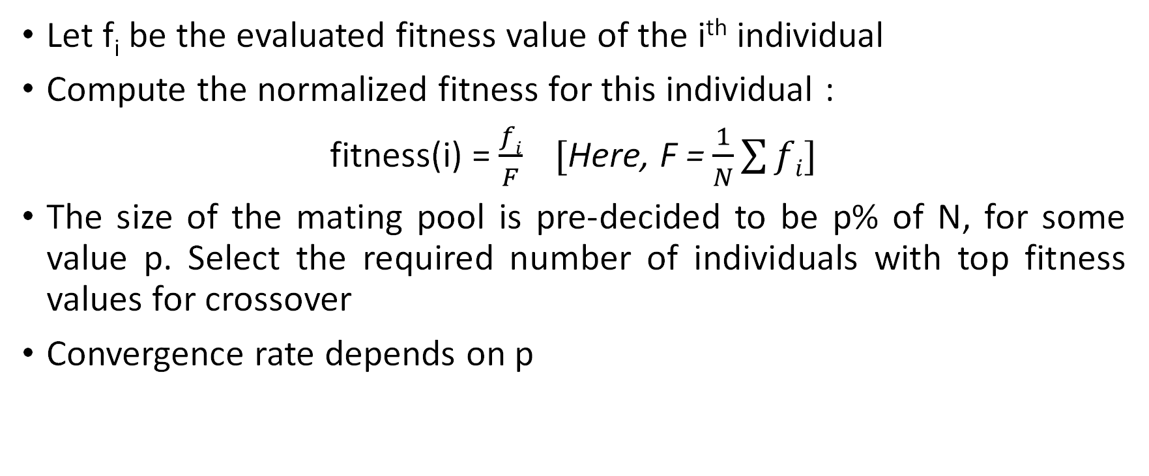
Canonical Selection
Let f_{i} be the evaluated fitness value of the i^{th} individual
Compute the normalized fitness for this individual :
fitness(i) = $\frac{fi}{F} [$Here, F = $\frac{1}{N}\sum{fi}]$
The size of the mating pool is pre-decided to be p% of N, for some value p. Select the required number of individuals with top fitness values for crossover
Convergence rate depends on p

Slide 10
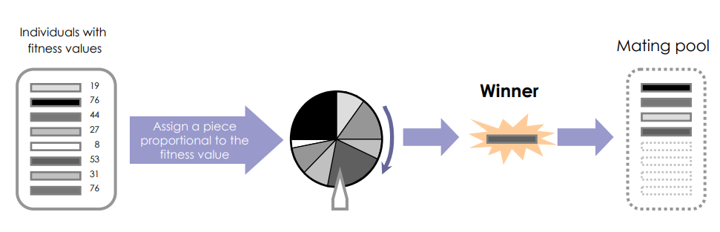
Roulette Wheel Selection

Slide 11
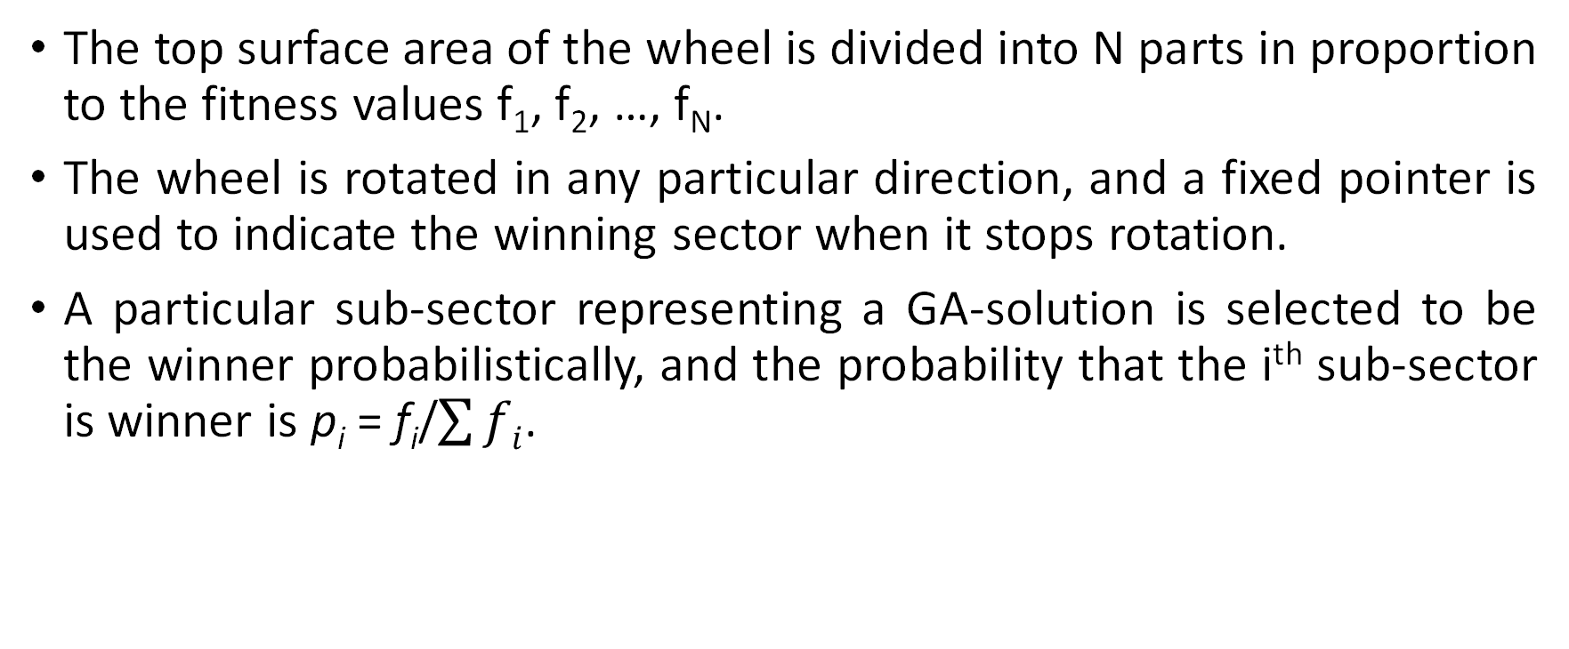
Roulette Wheel Selection
The top surface area of the wheel is divided into N parts in proportion to the fitness values f₁, f₂, …, f_{N}.
The wheel is rotated in any particular direction, and a fixed pointer is used to indicate the winning sector when it stops rotation.
A particular sub-sector representing a GA-solution is selected to be the winner probabilistically, and the probability that the i^{th} sub-sector is winner is p_{i} = f_{i}/$\sum{fi}$.

Slide 12
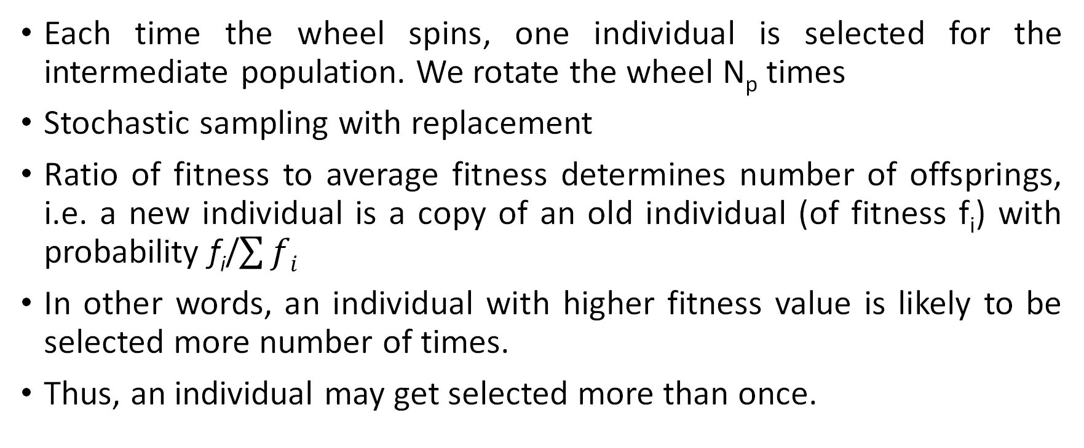
Roulette Wheel Selection
Each time the wheel spins, one individual is selected for the intermediate population. We rotate the wheel N_{p} times
Stochastic sampling with replacement
Ratio of fitness to average fitness determines number of offsprings, i.e. a new individual is a copy of an old individual (of fitness f_{i}) with probability f_{i}/$\sum{fi}$
In other words, an individual with higher fitness value is likely to be selected more number of times.
Thus, an individual may get selected more than once.

Slide 13
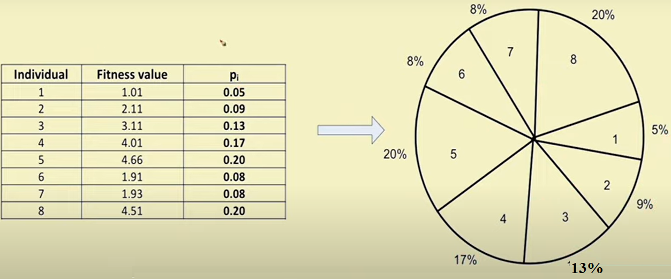
Example of Roulette Wheel Selection

Slide 14
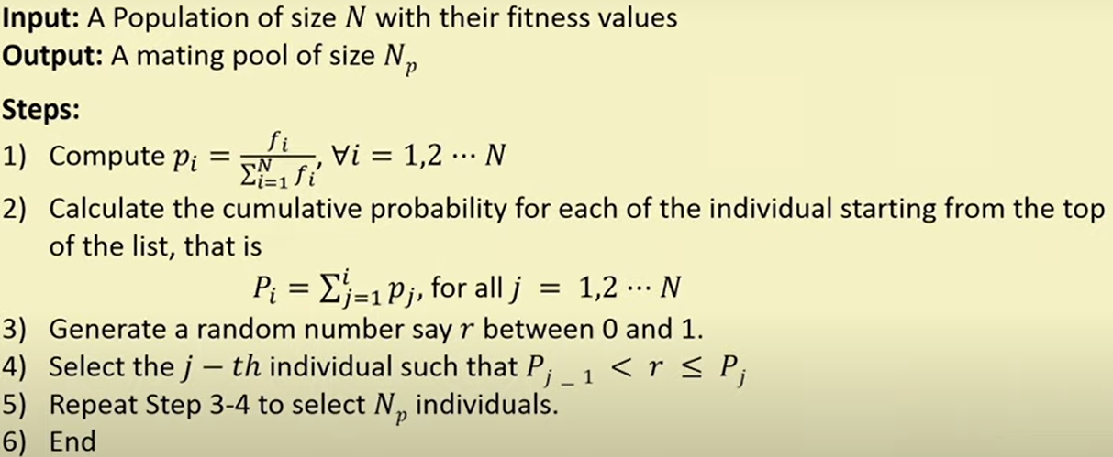
Algorithm for Roulette Wheel Selection

Slide 15
Limitations of Roulette Wheel Selection
Suppose there are four binary strings in a population with fitness values f₁, f₂, f₃, f₄.
Further, let these values be 80%, 10%, 6%, and 4%.

Slide 16
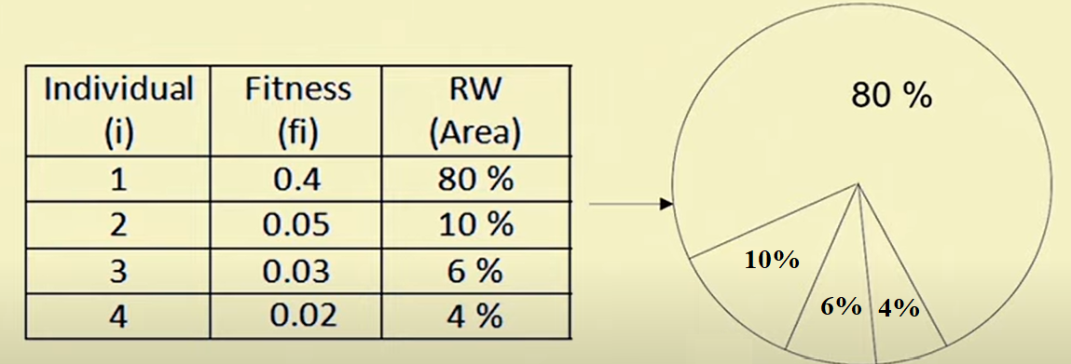
Limitations of Roulette Wheel Selection
Observe that individuals with higher fitness guards those with smaller fitness to get selected for mating
Results in lesser diversity and hence fewer scope towards exploring alternate solutions. Leads to premature convergence with local optimum solution.

Slide 17
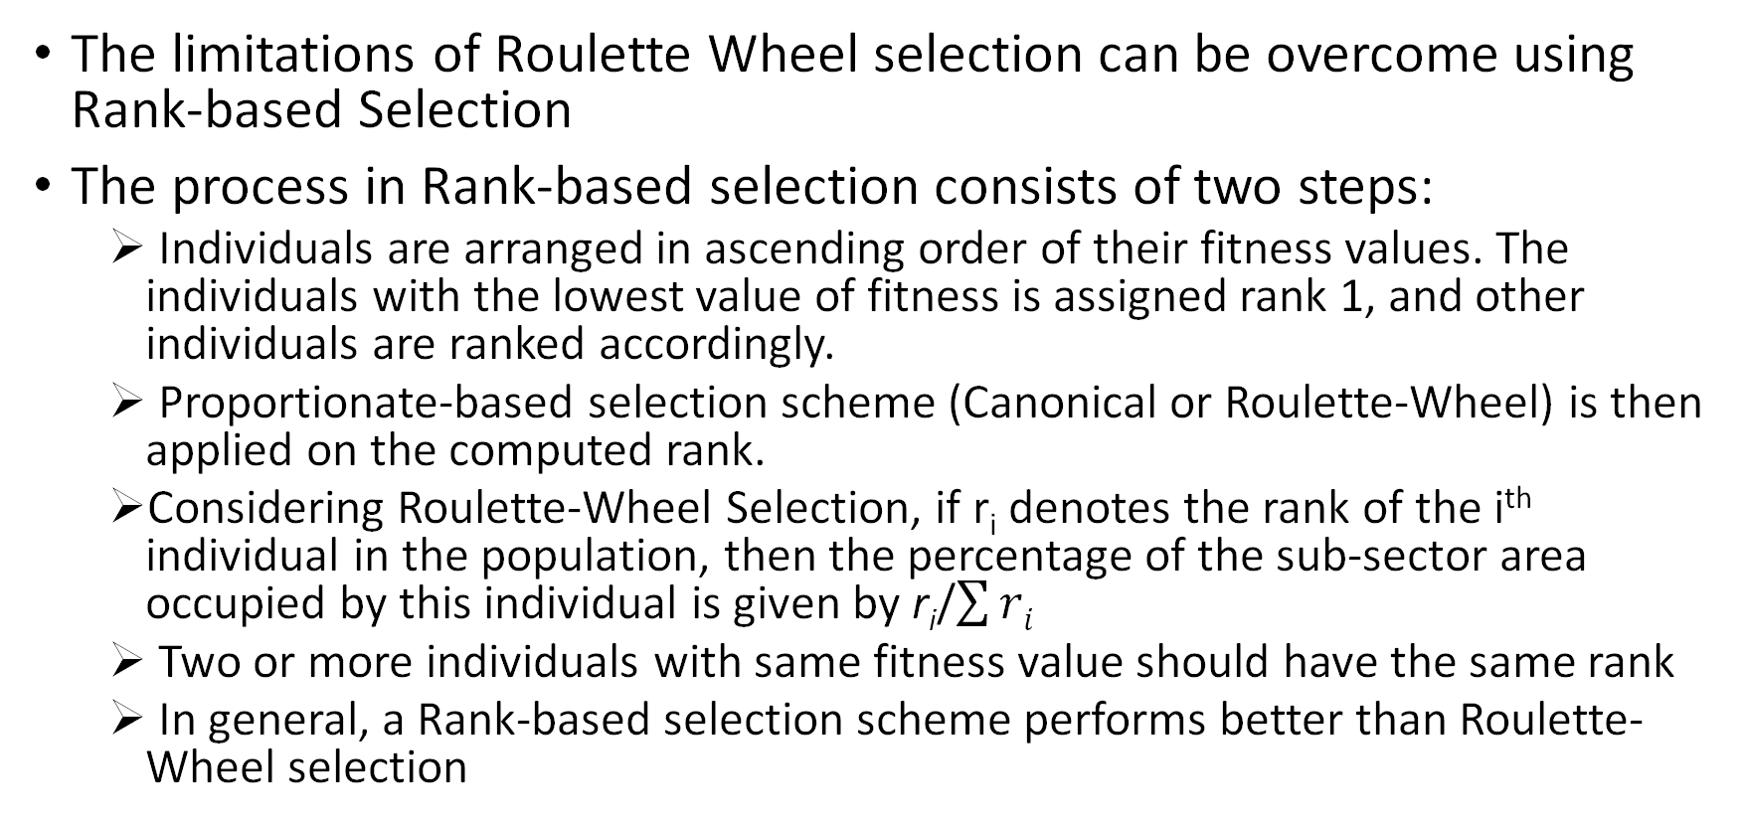
Rank-based Selection
The limitations of Roulette Wheel selection can be overcome using Rank-based Selection
The process in Rank-based selection consists of two steps:
Individuals are arranged in ascending order of their fitness values. The individuals with the lowest value of fitness is assigned rank 1, and other individuals are ranked accordingly.
Proportionate-based selection scheme (Canonical or Roulette-Wheel) is then applied on the computed rank.
Considering Roulette-Wheel Selection, if r_{i} denotes the rank of the i^{th} individual in the population, then the percentage of the sub-sector area occupied by this individual is given by r_{i}/$\sum{ri}$
Two or more individuals with same fitness value should have the same rank
In general, a Rank-based selection scheme performs better than Roulette-Wheel selection

Slide 18
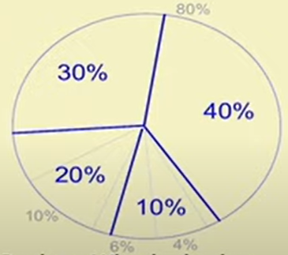
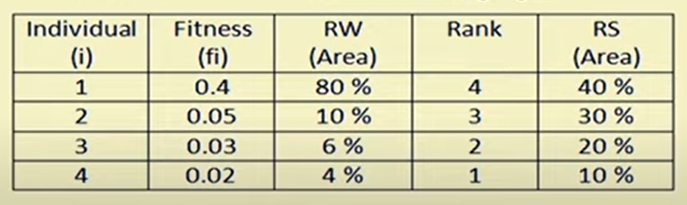
Rank-based Selection Example
Continuing with the previous example, where normalized fitness values of 4 individuals in the population are 0.40, 0.05, 0.03, and 0.02
Expection counts of bad individuals will be improved using this selection scheme. Higher chance of selection of inferior individuals

Slide 19
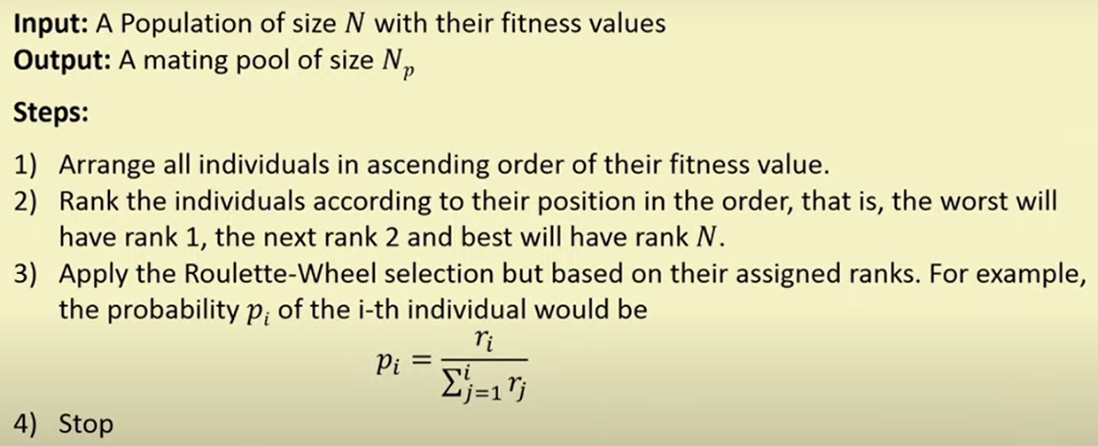
Algorithm for Rank-based Selection

Slide 20
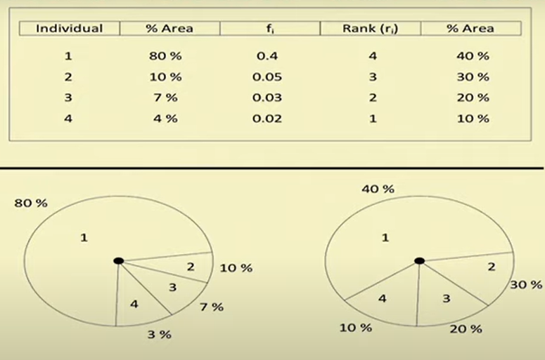
Two Types of Roulette-Wheel Selection Algorithms
Roulette-Wheel based on Proportionate-based Selection
Roulette-Wheel based on Ordinal-based Selection

Slide 21
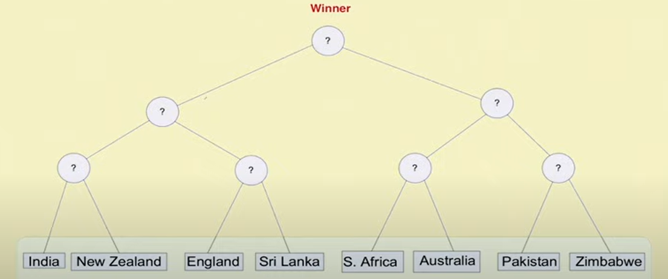
Tournament Selection
Based on knock-out match

Slide 22
Tournament Selection
Select the tournament size N_{u} at random
We pick N_{u} individuals from the population at random and determine the fittest one, i.e., the one with highest fitness
The best one is copied into the mating pool
One individual is selected from each tournament. To make a mating pool of size N_{p}, the tournament has to be played N_{p} times.
In this scheme, usually N_{p} is chosen to be equal to N.

Slide 23
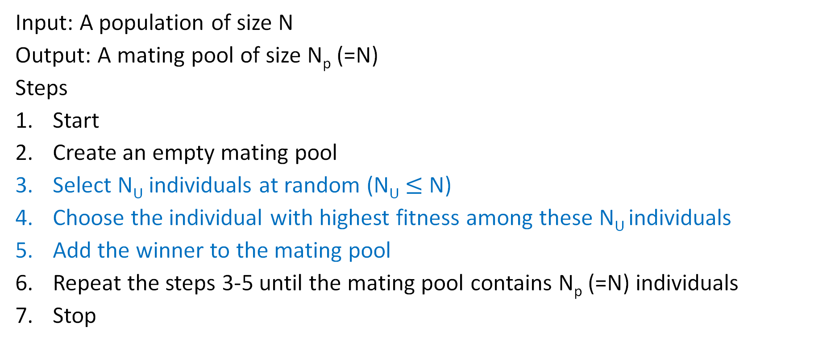
Algorithm for Tournament Selection
Input: A population of size N
Output: A mating pool of size N_{p} (=N)
Steps
Start
Create an empty mating pool
Select N_{U} individuals at random (N_{U} $≤$ N)
Choose the individual with highest fitness among these N_{U} individuals
Add the winner to the mating pool
Repeat the steps 3-5 until the mating pool contains N_{p} (=N) individuals
Stop

Slide 24
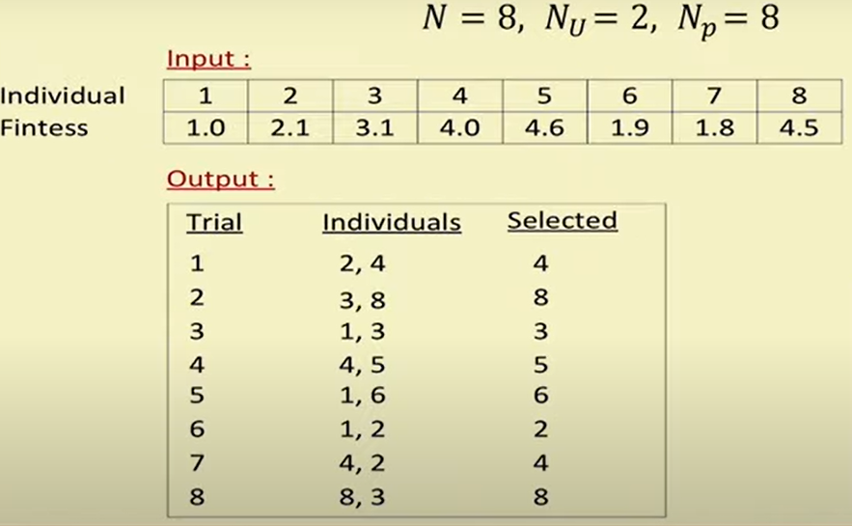
Tournament Selection Example

Slide 25
Tournament Selection
There is a chance for a good individual to be selected more than once in the mating pool
The technique is computationally faster than both Roulette-Wheel and Rank-based Selection Scheme

Slide 26
Steady-State Selection Algorithm
Very simple strategy
N_{u} individuals are randomly selected in an iteration. Usually N_{u} is a small number
Next, N_{u} individuals with worst fitness values will be replaced by N_{u} individuals selected in Step 1 and are added in the mating pool
The process is repeated until a mating pool of desired size is obtained

Slide 27
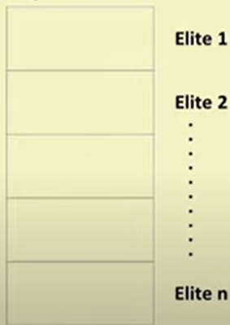
Elitism
An elite class (i.e., a set of strings) is identified from a population of strings
Basically, cluster the set of strings into several groups (say, n groups) based on the fitness values.
Elite 1 corresponds to the group with very high fitness values, and Elite n corresponds to the group with the lowest fitness values.
Strategy: Ensure that the best set of strings are placed in the mating pool
Select all chromosomes in Elite 1 group in the mating pool.
Apply Roulette-Wheel Selection to select the other chromosomes and create a mating pool of size N_{p}

Slide 28
General Discussion about the Selection Schemes
Selection schemes are inspired by Darwin’s Theory of Survival of the Fittest
Alternatively, the selection strategy in Gas is a process that favors the selection of better individuals of the population in the mating pool (with an aim to get genes inherited in the next generation), leading to a near optimal solution
Effectiveness of any selection scheme is decided based on two factors:
Population Diversity
Selection Pressure

Slide 29
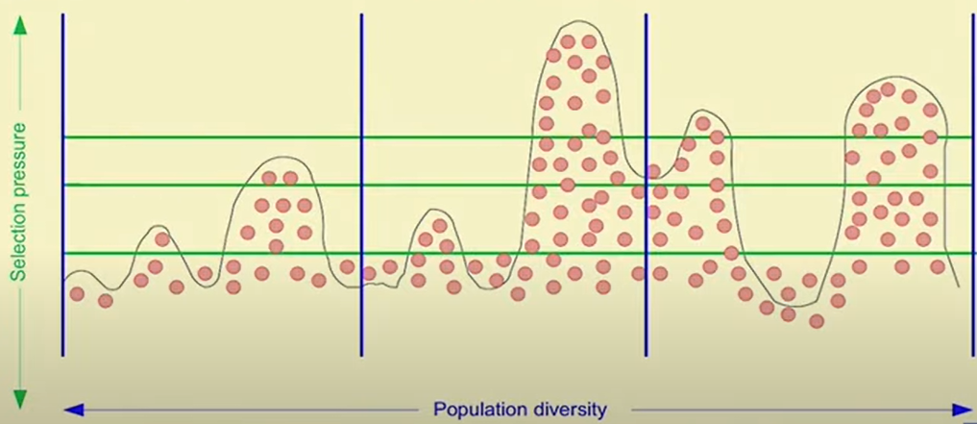
General Discussion about the Selection Schemes
Exploration and Exploitation
In Exploration, the algorithm searching for new solutions in new regions
Exploitation means using already exist solutions and make refinement to it so it's fitness will improve.
A higher population diversity means a higher exploration
Higher selection pressure means lesser exploitation

Slide 30
Effectiveness of Any Selection Scheme
Population Diversity
Similar to the concept of exploration
Genes from the already discovered fitter individuals are exploited while permitting the new area of search space to be explored
Selection Pressure
Degree to which fitter individuals are preferred during selection
The above two factors are inversely related to each other in the sense that if selection pressure increases, population diversity decreases and vice versa

Slide 31
Effectiveness of Any Selection Scheme
If selection pressure is very high,
Search focuses on good individuals more
Loses population diversity
Higher rate of convergence. Often results in pre-mature convergence with sub-optimal solution
If selection pressure is very low,
Population diversity increases since fitter as well as weaker genes may get selected for reproduction
Lower rate of convergence. Longer time is needed to find optimal solution
More chance of not selecting the better individuals in the mating pool, ultimately leading to stagnation

Slide 32
Homework
Compare the different selection schemes on the basis of population diversity and selection pressure

Slide 33
THANK YOU

